Slide 1
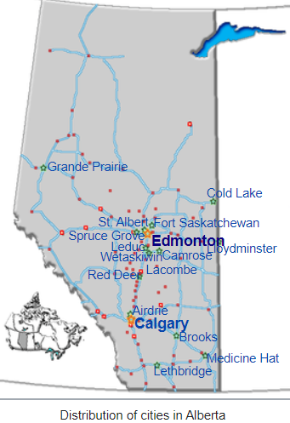
Capstone Project The Battle of the Neighborhoods (Week 2) Applied Data Science Capstone by IBM/Coursera
By.. Rungrat J.

Slide 2
Introduction: Business Problem
In this project we will try to find an optimal location for a restaurant. Specifically, this project will be targeted to stakeholders interested in opening restaurant in Alberta, Canada.
Since there are lots of restaurants in Alberta, we will try to detect locations that are not already crowded with restaurants. We would also prefer locations as close to city center as possible.

Slide 3
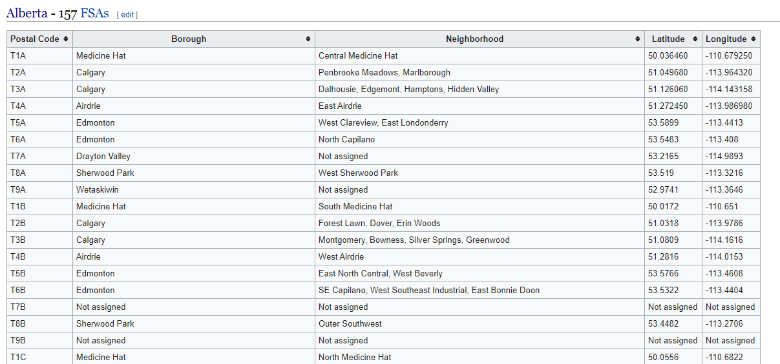
Data
Focus Data
number of existing restaurants in the neighborhood (any type of restaurant)
distance of neighborhood from city center
Data Source
The neighborhood dataset is available on this Wikipedia page.
Get the information about Borough, Neighborhood, latitude, Longitude from latitude from Wikipedia page. https://en.wikipedia.org/wiki/List_of_postal_codes_of_Canada:_T
number of restaurants and their type and location in every neighborhood will be obtained using Foursquare API

Slide 4
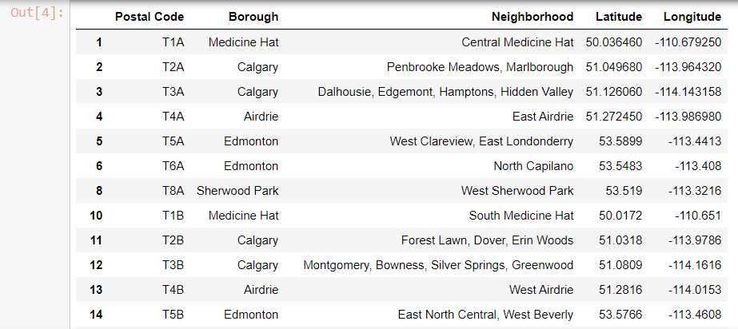
METHODOLOGY
Get the data using BeautifulSoup
Cleansing and structuring data to below format
Use geopy library to get the latitude and longitude values of Edmonton, Alberta.
Use Folium library to make a great visualization. Feel free to zoom into the above map and click on each circle mark to reveal the name of the neighborhood and its respective borough.
Segment the neighborhoods in Alberta using Foursquare API
Cluster Neighborhoods by using k-means to cluster the neighborhood into 5 clusters.
Examine Clusters, examine each cluster and determine the discriminating venue categories that distinguish each cluster.

Slide 5
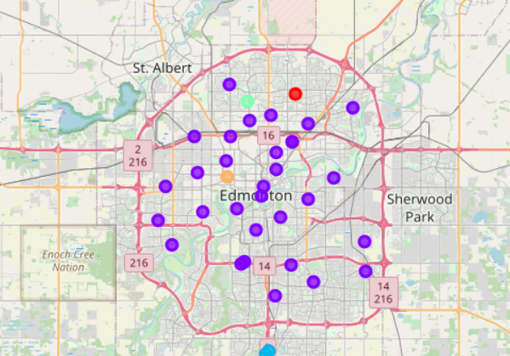
RESults
Finally, we can find the good location for opening a restaurant in Edmonton City, Alberta, Canada.
Edmonton City has 38 neighborhoods.
We try to detect locations that are not already crowded with restaurants. We would also prefer locations as close to city center as possible.
From Edmonton's neighborhood, we found 7 venues, 129 unique categories were returned by Foursquare within a radius of 500 meters.
And we cluster the Edmonton's neighborhood to 5 clusters by using k-means.
The result from clustering, some clusters have many restaurants. Some clusters also have Thai restaurants in most common venue. Some clusters don't have Thai restaurants.

Slide 6
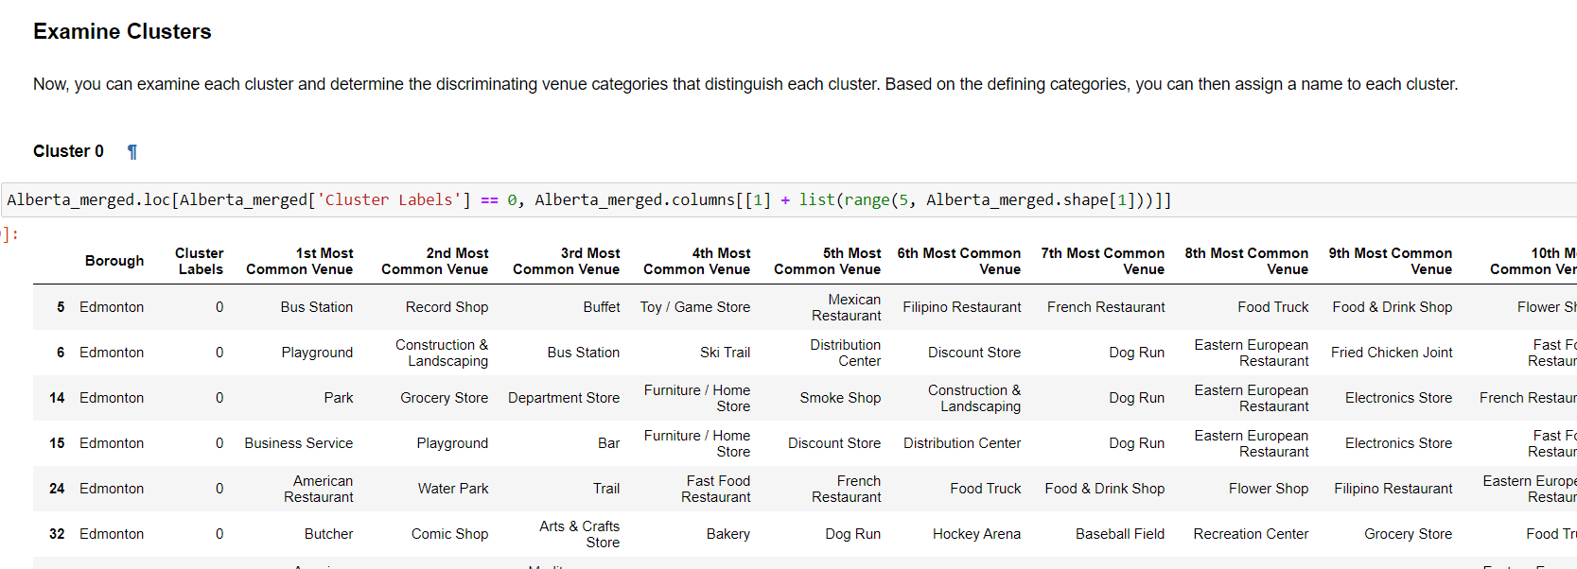
Discussion
We prefer the cluster that don't have Thai restaurants and be close to city center. And more notices, some cluster has many Asian restaurants, maybe we consider separating from the existing Asian restaurants.

Slide 7
Conclusion
Purpose of this project was to identify Edmonton areas close to Alberta center. Clustering of those locations was then performed in order to create zones of interest and addresses of those zone centers were created to be used as starting points for final exploration by stakeholders.
Final decision about optimal restaurant location will be made by stakeholders based on specific characteristics of neighborhoods and locations in every recommended zone, taking into consideration additional factors like attractiveness of each location (proximity to park or water), levels of noise / proximity to major roads, real estate availability, prices, social and economic dynamics of every neighborhood etc.

Slide 8
Thank you

